Slide 1

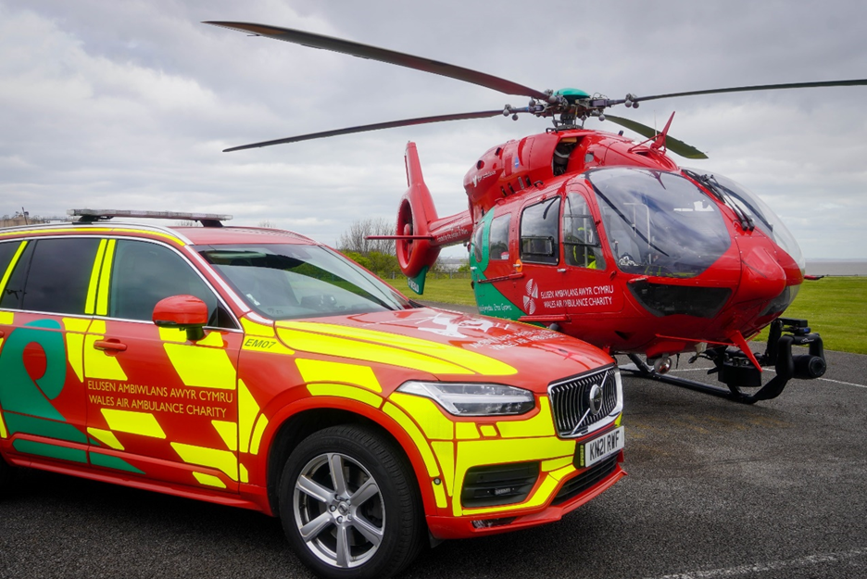


Emergency Ambulance Services Committee
Service Development Proposal
HTTPS://EASC.NHS.WALES
CTM_CASC_EASC@WALES.NHS.UK

Slide 2
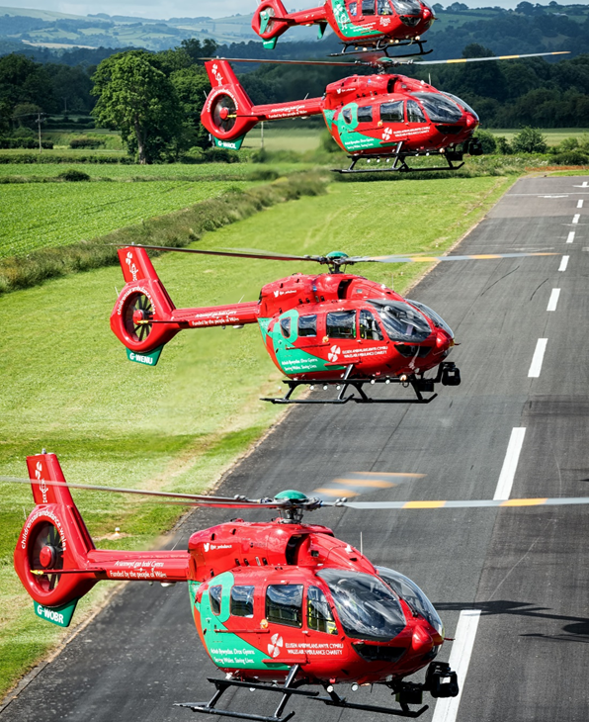
Background
  Opportunity has arisen for an exciting service development.
  NHS required to work with the Community Health Councils (CHC).
  Important that you understand what we are presenting.
  No decision has been made by the Emergency Ambulance Services Committee (EASC).
  Independent process led by the Chief Ambulance Services Commissioner (CASC)
    Ensure all views are considered in the decision-making process.
    Ensure the key issues are understood.
    Not just about facts and figures.
    National and local perspectives.
    Consistency with the Commissioning Intentions.
  Recommendation for EASC
HTTPS://EASC.NHS.WALES
Service Development Proposal
CTM_CASC_EASC@WALES.NHS.UK

Slide 3
EASC Governance Arrangements
NHS Wales Local Health Boards
Chief Ambulance Services Commissioner (CASC)
Emergency Ambulance Services Joint Committee (EASC)
Cwm Taf Morgannwg University Health Board:
Audit & Risk Committee
Quality & Safety Committee
EASC Management Group
Emergency Medical Retrieval and Transfer Service (EMRTS) Delivery Assurance Group
Non-Emergency Patient Transport Service (NEPTS) Delivery Assurance Group
Internal and External Assurance
Community Health Councils (CHC) and Patient Groups
Statutory Inspections (Health & Safety Executive etc.)
Regulatory Bodies
(Healthcare Inspectorate Wales, Care Quality Commission etc.)
Collaborative Quality Initiatives
(Improvement Cymru etc.)
Internal & External Audit
Internal and External Audit
HTTPS://EASC.NHS.WALES
Service Development Proposal
CTM_CASC_EASC@WALES.NHS.UK

Slide 4





EASC Partnership Arrangements
EASC
Commissioning Framework and Commissioning Intentions
The commissioner, Independent oversight
EMRTS Cymru
Delivering in line with agreed Commissioning Framework and Commissioning Intentions
WAAC
Charity’s strategic direction and objectives, aviation procurement opportunities and maximise utilisation of resources.
Clinicians, Medical Equipment
Airbases, Fuel, Engineers, Pilots, Helicopters, Rapid Response Vehicles
HTTPS://EASC.NHS.WALES
Service Development Proposal
CTM_CASC_EASC@WALES.NHS.UK

Slide 5
EASC Commissioning Intentions
  Collaborative commissioning approach.
  Developed with health boards, setting out the strategic priorities of the Committee for the next financial year.
  Focus on outcomes, value, quality and safety of service delivery and aim to ensure reasonable expectations for the ongoing improvement of these services.
  For 2022-23, Commissioning Intentions are:
    Service Expansion
    Adult Critical Care Transfer Service (ACCTS)
    Service Evaluation
    System Transformation - An agreed commissioning intention for all commissioned services: A collaboratively developed demand and capacity strategy including the use of forecasting, modelling and health economic evaluations.
HTTPS://EASC.NHS.WALES
Service Development Proposal
CTM_CASC_EASC@WALES.NHS.UK

Slide 6
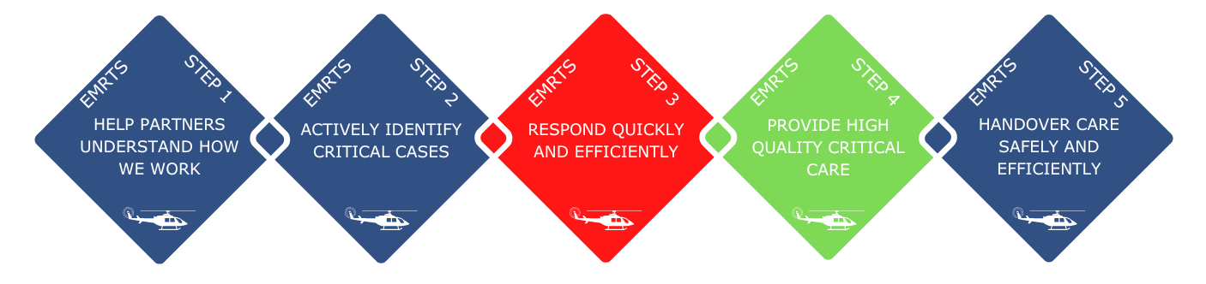
EASC Commissioning Framework
  EMRTS are commissioned “to provide advanced decision making & critical care for life or limb threatening emergencies that require transfer for time critical specialist treatment at an appropriate facility.”
  Framework includes an evidenced set of care standards against the agreed EMRTS 5-step patient care pathway.
HTTPS://EASC.NHS.WALES
Service Development Proposal
CTM_CASC_EASC@WALES.NHS.UK

Slide 7
EASC Commissioning Framework
  EMRTS developed to bring specific benefits to Wales:
    Reductions in geographical inequity for patients with critical care needs.
    Health gains by improving clinical outcomes.
    Improved clinical and skills sustainability – improving the clinical skills, recruitment and retention in key acute care areas.
  The service has two main areas of activity:
    Pre-hospital critical care for all age groups (i.e. interventions/decisions that are outside standard paramedic practice).
    Undertaking time-critical, life or limb-threatening adult and paediatric transfers from peripheral centres for patients requiring specialist intervention at the receiving hospital.
HTTPS://EASC.NHS.WALES
Service Development Proposal
CTM_CASC_EASC@WALES.NHS.UK

Slide 8


EMRTS: Average Day
1,300
1,100
999 calls received by WAST
999 calls screened by EMRTS
140
13
3
999 calls triaged for deployment by EMRTS
Calls identified as EMRTS appropriate following triage
cases of unmet need
(no resource to send)
87
Other incoming calls triaged for deployment by EMRTS
NOTE
Welsh Ambulance Services allocated the nearest available resource regardless of EMRTS deployment
10
8
NOTE
Calls allocated to EMRTS resources
allocated calls attended scene by EMRTS
Welsh Ambulance Services allocated the nearest available resource regardless of EMRTS deployment
5
3
Patients received critical care by EMRTS
Patients received enhanced care by EMRTS
HTTPS://EASC.NHS.WALES
Service Development Proposal
CTM_CASC_EASC@WALES.NHS.UK

Slide 9
EMRTS: Average Day
1,300
1,100
999 calls received by WAST
999 calls screened by EMRTS
140
13
3
999 calls triaged for deployment by EMRTS
Calls identified as EMRTS appropriate following triage
cases of unmet need
(no resource to send)
87
Other incoming calls triaged for deployment by EMRTS
NOTE
Welsh Ambulance Services allocated the nearest available resource regardless of EMRTS deployment
10
8
NOTE
Calls allocated to EMRTS resources
allocated calls attended scene by EMRTS
Welsh Ambulance Services allocated the nearest available resource regardless of EMRTS deployment
5
3
Patients received critical care by EMRTS
Patients received enhanced care by EMRTS
HTTPS://EASC.NHS.WALES
Service Development Proposal
CTM_CASC_EASC@WALES.NHS.UK

Slide 10
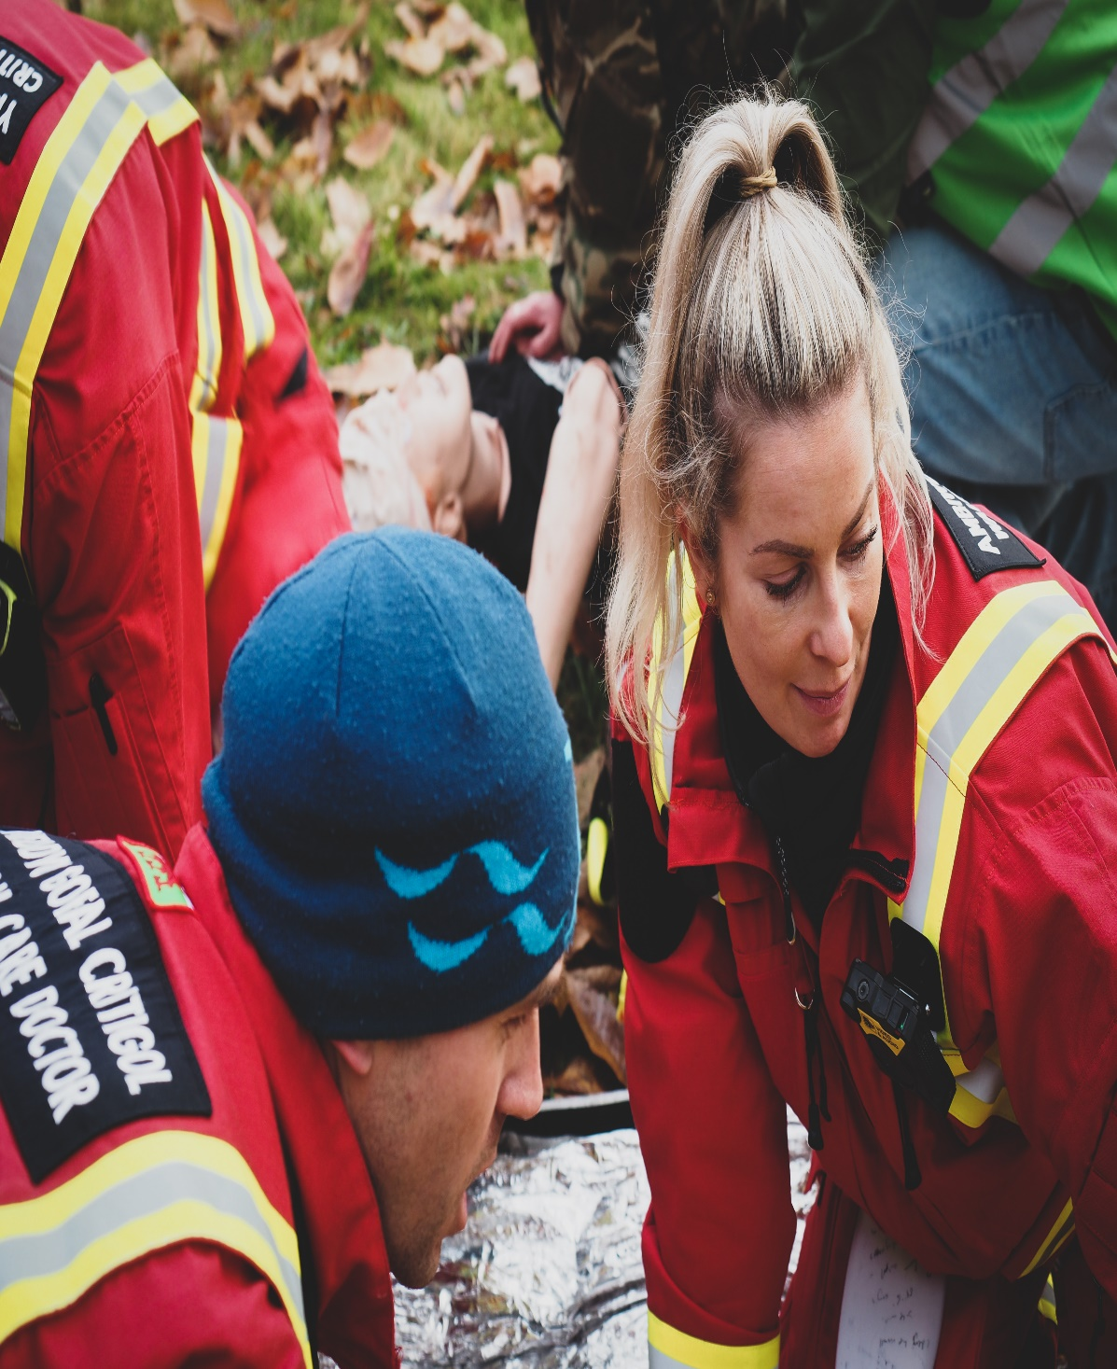
Independent Service Evaluation 2015-2020
Increased chance of survival​
A significant 37% reduction in mortality after 30 days for patients with serious blunt trauma.
Flying emergency department​
63% of patients (6,018) had treatments at the scene of their incident which previously they could only have within a hospital (including blood transfusions and anaesthesia).
Taking the patients to the right place, first time​
Thanks to advanced decision-making, 42% of patients bypassed local hospitals to be taken directly to specialist care – saving time for the patient and extra resources for the NHS.
Attracting consultants into Wales​
12 new consultants had been recruited into Wales due to the attraction of working with Wales Air Ambulance.
HTTPS://EASC.NHS.WALES
Service Development Proposal
CTM_CASC_EASC@WALES.NHS.UK

Slide 11
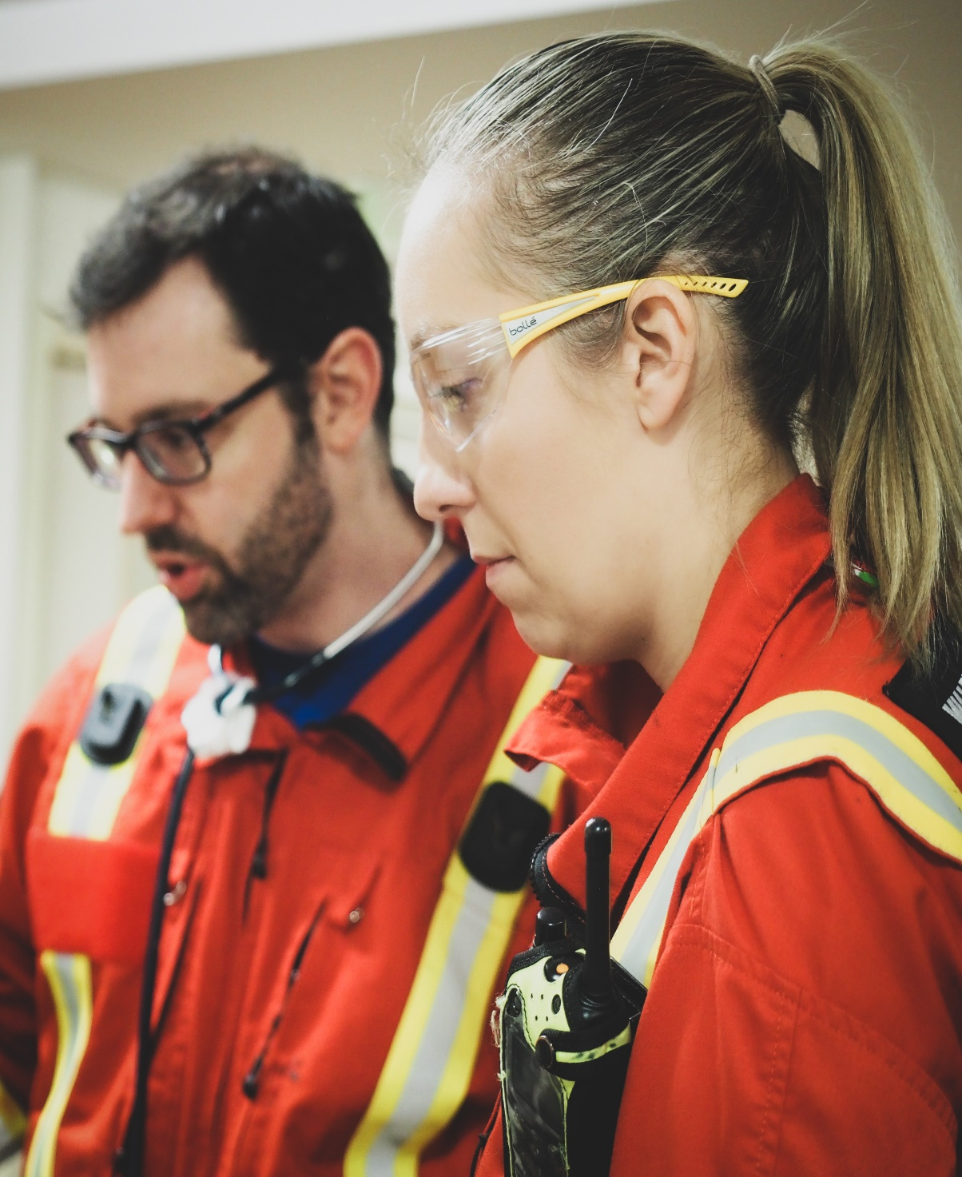
Modelling and Conclusions​
  Service analysis undertaken by EMRTS, detailed modelling by independent experts.
  Offer different medical shifts operational from a central North Wales location to cover Mid and North Wales. One shift operating 8am to 8pm​ and another from 2pm to 2am (increasing coverage based in the region by 6 hours).​
  Appropriate utilisation of aircraft.​
  Enhance day-time provision with extended after-dark capability. ​
  Optimise the existing South Wales resources to meet demand.​
  Reposition current Caernarfon and Welshpool crews to a central North Wales location close to the A55 (Denbighshire or Conwy). ​
HTTPS://EASC.NHS.WALES
Service Development Proposal
CTM_CASC_EASC@WALES.NHS.UK

Slide 12
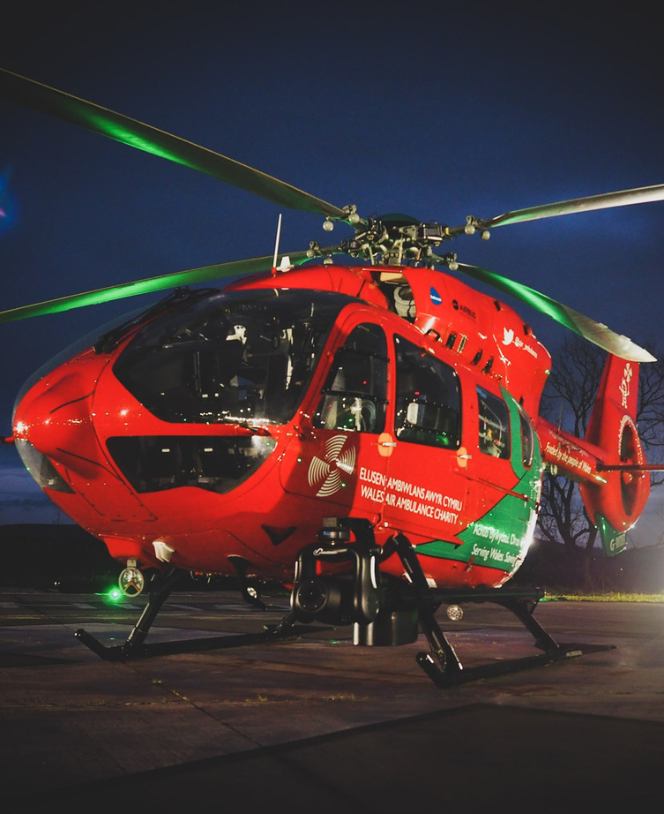
What does this mean?
2021 Baseline | Service Development Proposal
4 teams, each with an aircraft and rapid response vehicles: 3x Day shifts (2x Consultant) – 8am to 8pm 1x Night shift (Consultant) – 8pm to 8am | 5 teams, each with an aircraft and rapid response vehicles: 3x Day shifts (2x Consultant) – 8am to 8pm 1x Twilight shift – 2pm to 2am 1x Night shift (Consultant) – 8pm to 8am
4 Bases | 3 Bases
24/7 response | 24/7 response (additional cover for 6 hours)
Answering 72% of overall demand | Answering 88% of overall demand
Regularly respond from any base to any part of Wales | Regularly respond from any base to any part of Wales
 | Extended hours for Mid and North Wales additional 2,200 hours per annum (6 hours per day) locally
HTTPS://EASC.NHS.WALES
Service Development Proposal
CTM_CASC_EASC@WALES.NHS.UK

Slide 13
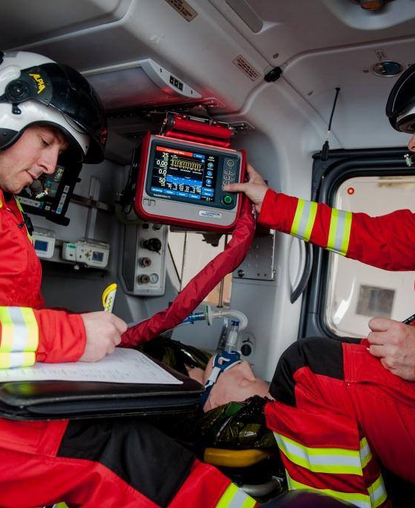
What are the benefits?
Potential to attend 583 additional lifesaving missions every year*. ​
Currently meeting 72% of total demand.​ The proposed service development would potentially allow us to ​achieve 88% of total demand*.
*Optima modelling using 2021 data
HTTPS://EASC.NHS.WALES
Service Development Proposal
CTM_CASC_EASC@WALES.NHS.UK

Slide 14
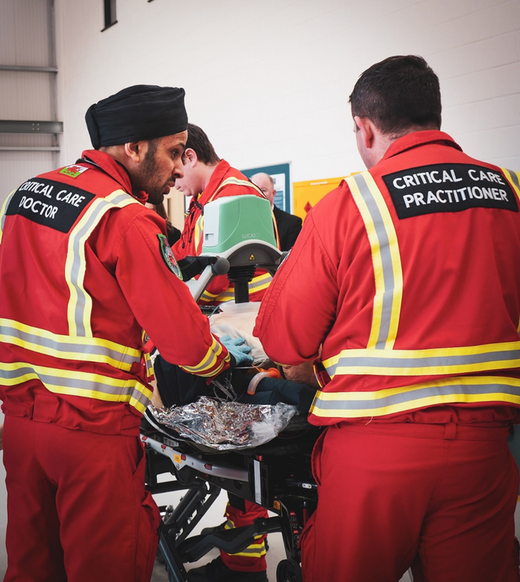
Questions
HTTPS://EASC.NHS.WALES
Service Development Proposal
CTM_CASC_EASC@WALES.NHS.UK

Slide 15

Next Steps
    Ensure all views are considered in the decision-making process.
    Ensure the key issues are understood.
  All-Wales CHC Service Planning Meeting 20 October.
  Service development proposal to EASC 8 November.
  Follow process required by CHC.
  EASC decision early 2023.
HTTPS://EASC.NHS.WALES
Service Development Proposal
CTM_CASC_EASC@WALES.NHS.UK

