Slide 1

EASC 10-11-2020
BEYOND THE CALL
NATIONAL REVIEW OF ACCESS TO EMERGENCY SERVICES FOR THOSE EXPERIENCING MENTAL HEALTH AND/OR WELFARE CONCERNS

Slide 2

Mental Health & Welfare Concerns
Mental well-being/mental illness/mental disorder/mental health
Welfare
Distress/ resilience
Barriers to access: children, young adults, black and minority ethnic communities, LGBT asylum seekers/refugees, perinatal problems, less affluent and middle aged men, armed forces veterans, people with intellectual disabilities and older adults.
NATIONAL REVIEW OF ACCESS TO EMERGENCY SERVICES FOR THOSE EXPERIENCING MENTAL HEALTH AND/OR WELFARE CONCERNS
A mental health and/or welfare crisis describes any situation in which an incident related to public safety or individual welfare prompts a call to emergency services and is linked to a person’s mental health or wellbeing.
The person may be at immediate risk of harming themselves or others, or an immediate risk of being unable to adequately care for themselves or be cared for within existing support structures or function safely in the community, and where there is an identified trigger or vulnerability associated with their diagnosed mental health condition, or other social, emotional or clinical situation.

Slide 3
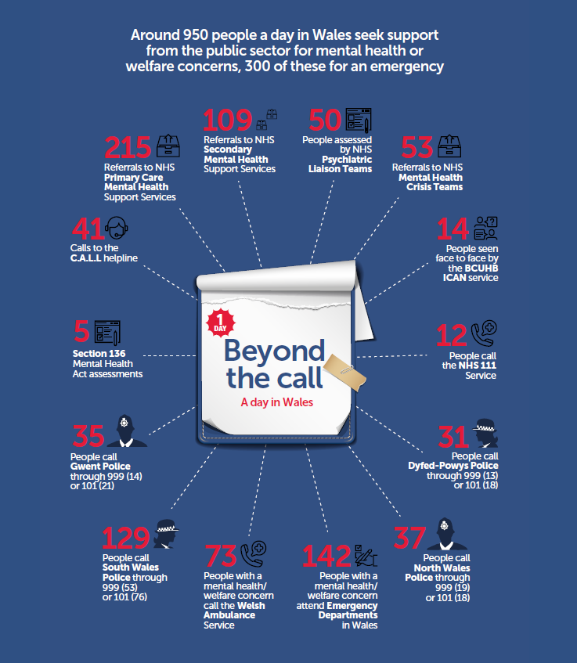
Public Services
Public Sector/Third Sector
Primary Care
Community MH services
Ambulance services
NHS 111
Emergency Departments
Social care
Police
Fire & Rescue
NATIONAL REVIEW OF ACCESS TO EMERGENCY SERVICES FOR THOSE EXPERIENCING MENTAL HEALTH AND/OR WELFARE CONCERNS
Data Services
  Annual reports
  Snapshot data
  Requests
  Research
Data Bespoke
  10,175 calls
  21,023 separate index problems
Graphic is for illustrative purposes only. Numbers are averages.
Exact figures are 946 overall, 319 classed as emergency (‘999’
calls to police and ambulance and attendance at emergency
department). Police data is from MH snapshot day November
2019. Emergency department is 4% of attendances. Other data
is from bespoke data requests or published data. Data does not
include social care, third sector or telephone helpline support.
Police figures do not include persons in custody with mental
health flags or missing person calls. Some overlap may occur as
calls to police could result in ambulance call, emergency
department attendance or NHS mental health services referral,
similarly calls to ambulance or NHS 111 could result in police
calls, emergency department attendance or referral to NHS
mental health service. Some emergency department figures could
include subsequent referral to psychiatric liaison or ICAN services.
Many calls or referrals could result in an assessment with no
determination of a mental illness. Numbers could refer to single
calls from single person, multiple calls from a single person or
multiple calls about a single person.

Slide 4
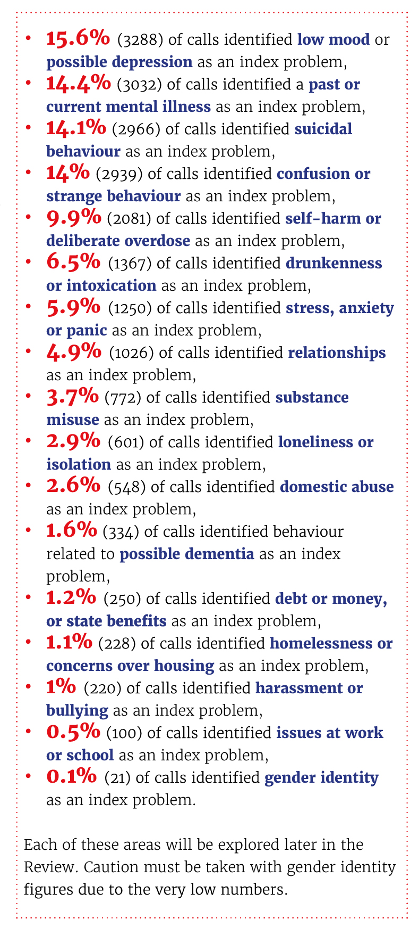
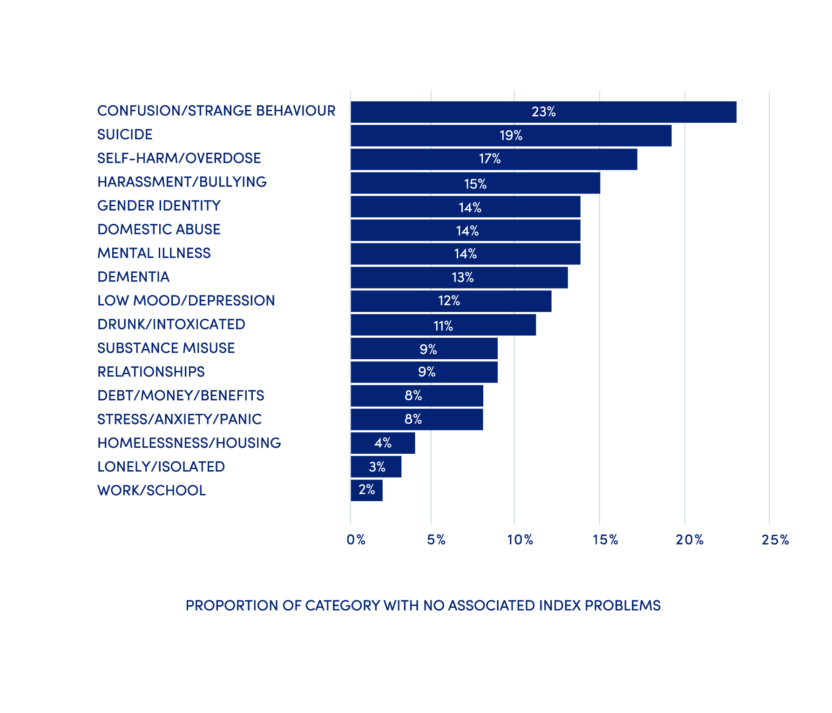
Index problems
NATIONAL REVIEW OF ACCESS TO EMERGENCY SERVICES FOR THOSE EXPERIENCING MENTAL HEALTH AND/OR WELFARE CONCERNS

Slide 5
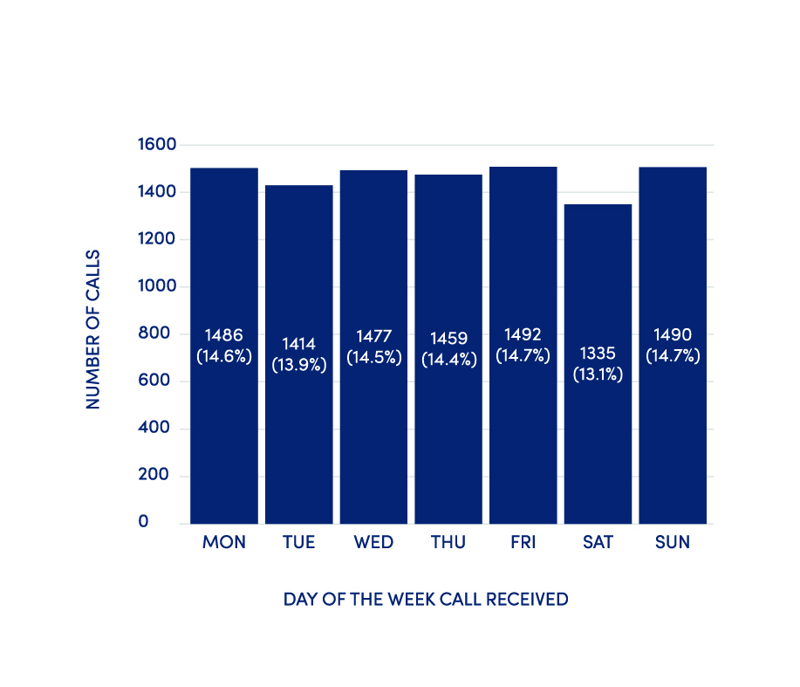
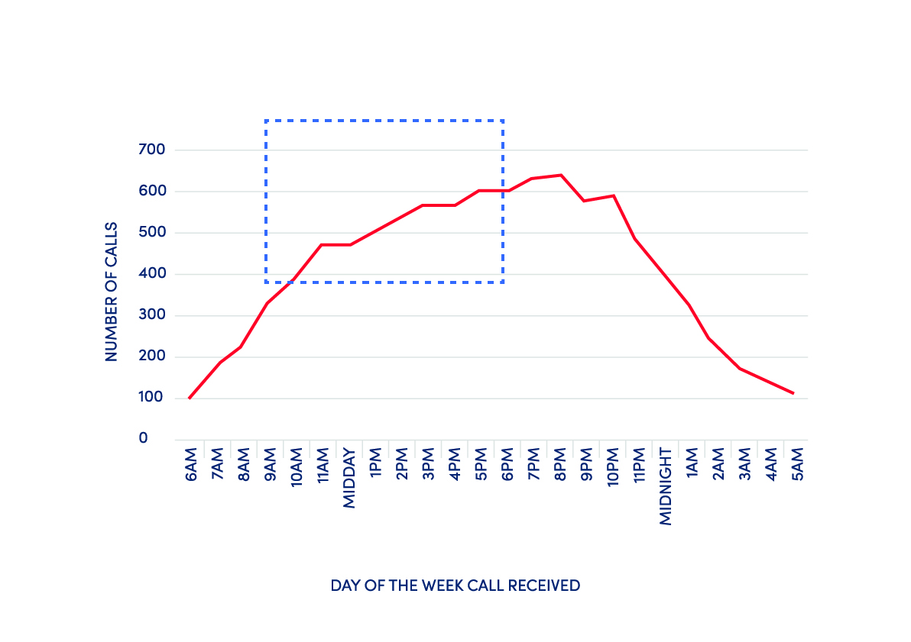
General Data Day/time
Figure 1: Proportion of calls received per day of the Week Received
Figure 2: Number of calls received by time of day per hourly intervals
NATIONAL REVIEW OF ACCESS TO EMERGENCY SERVICES FOR THOSE EXPERIENCING MENTAL HEALTH AND/OR WELFARE CONCERNS

Slide 6
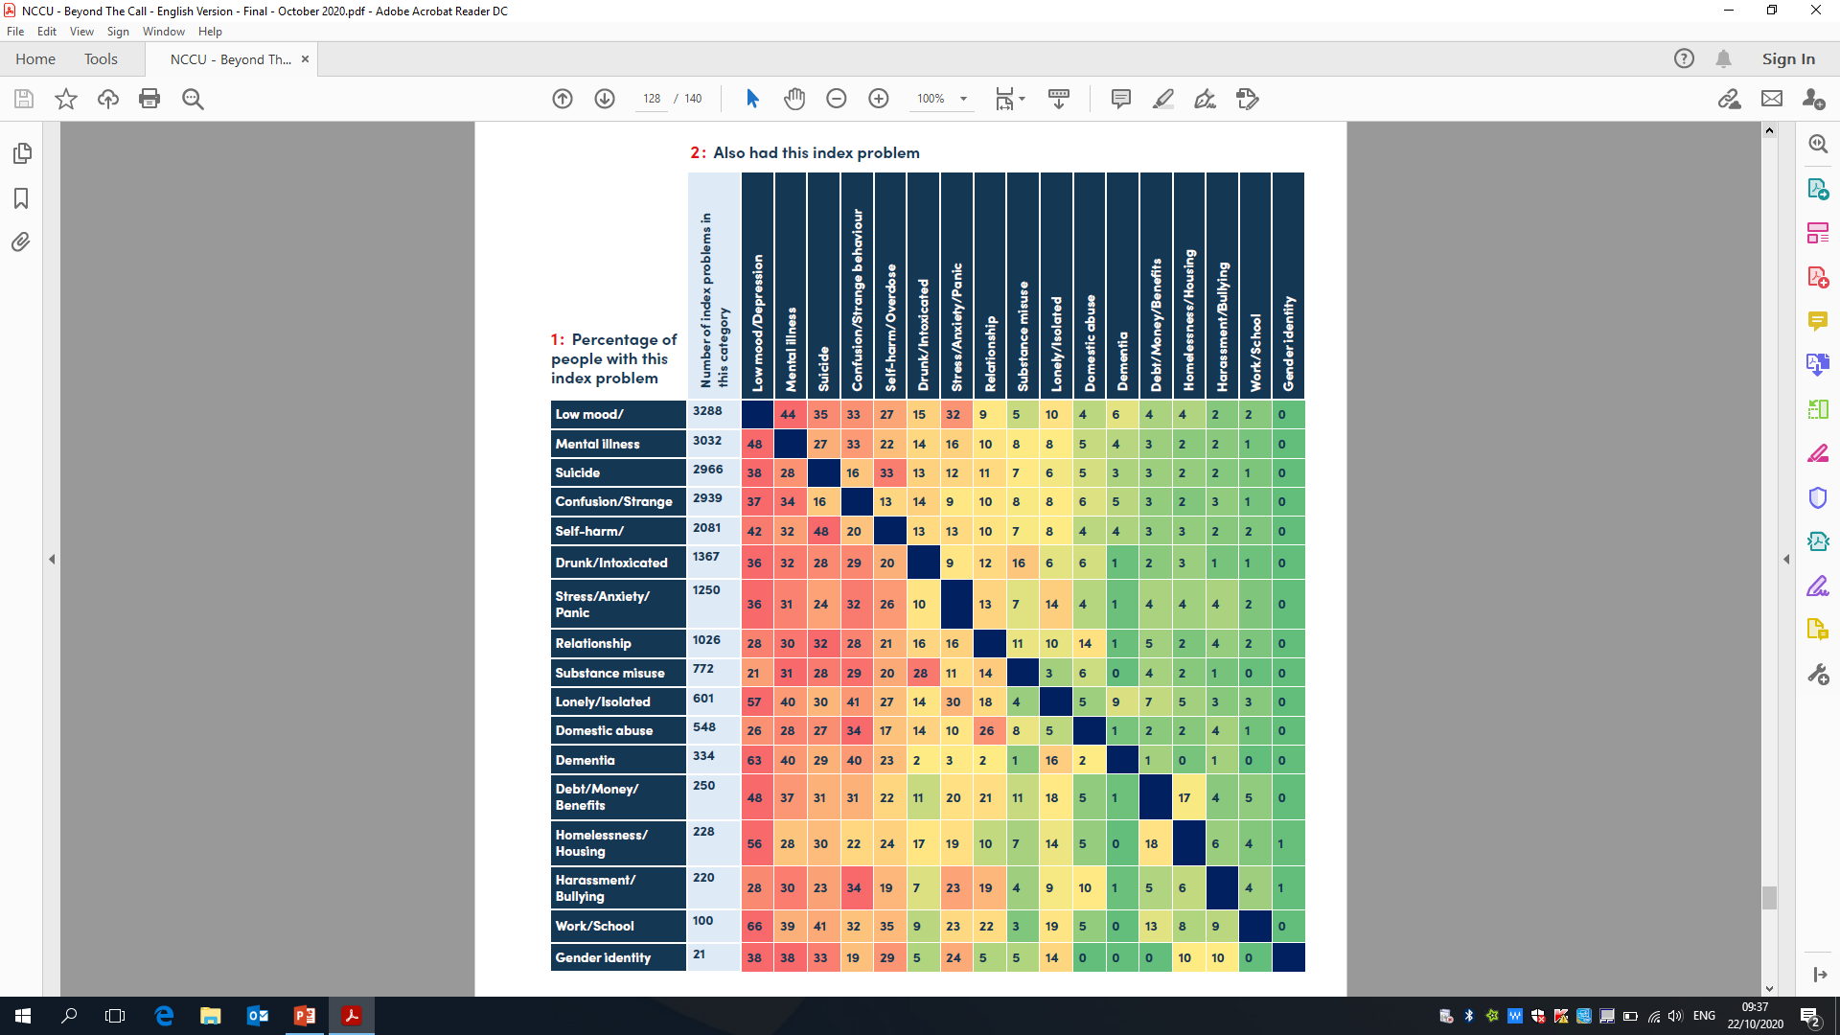
Relationship between index problems
NATIONAL REVIEW OF ACCESS TO EMERGENCY SERVICES FOR THOSE EXPERIENCING MENTAL HEALTH AND/OR WELFARE CONCERNS

Slide 7
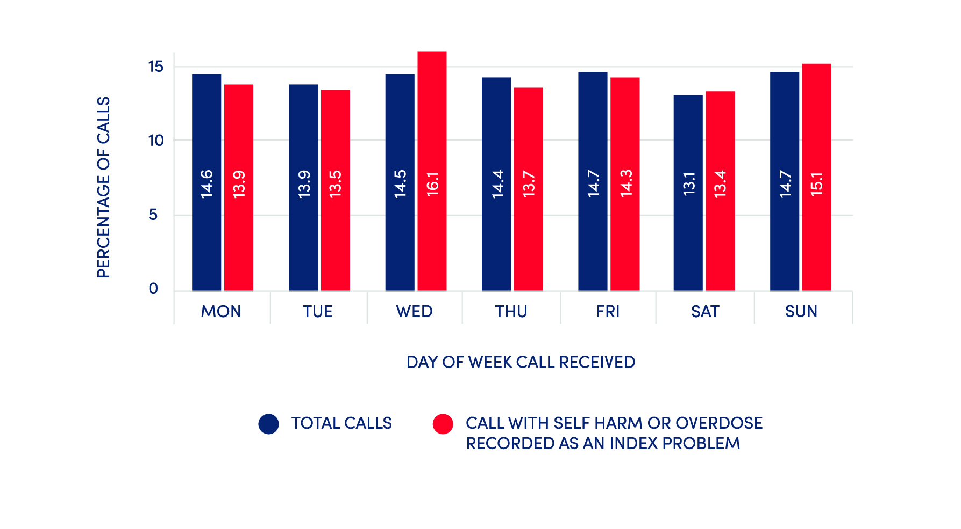
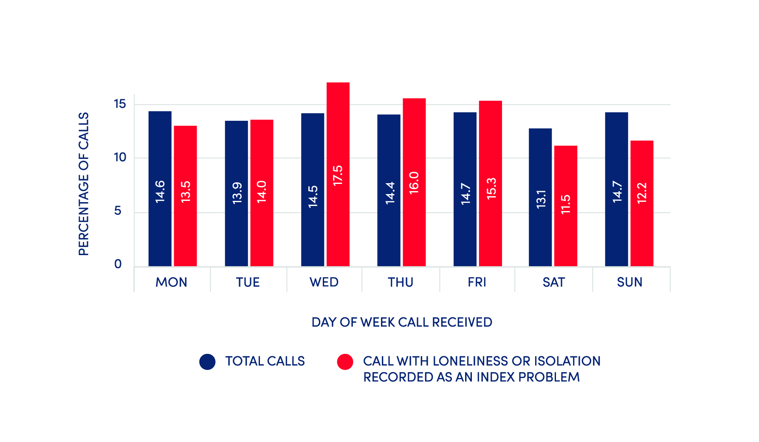
Calls by Day of the Week
Self harm/Overdose Verses Total Calls
Loneliness Verses Total Calls
NATIONAL REVIEW OF ACCESS TO EMERGENCY SERVICES FOR THOSE EXPERIENCING MENTAL HEALTH AND/OR WELFARE CONCERNS

Slide 8
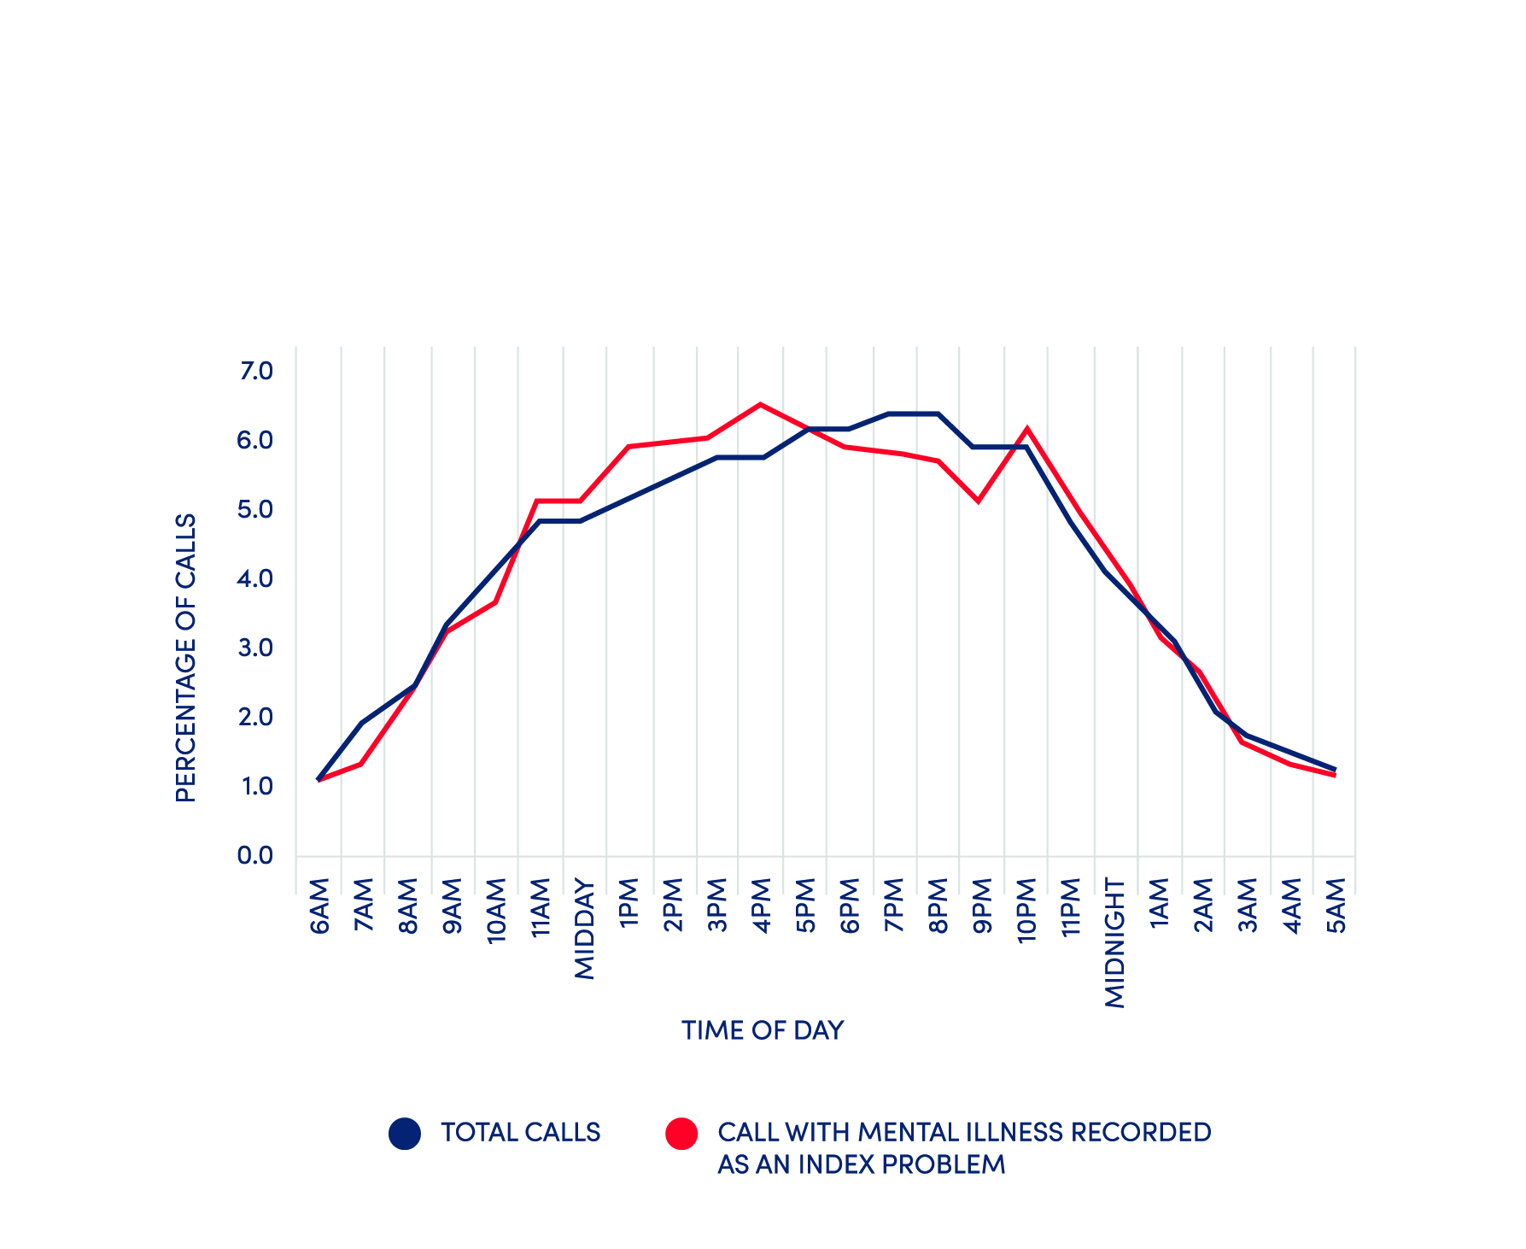
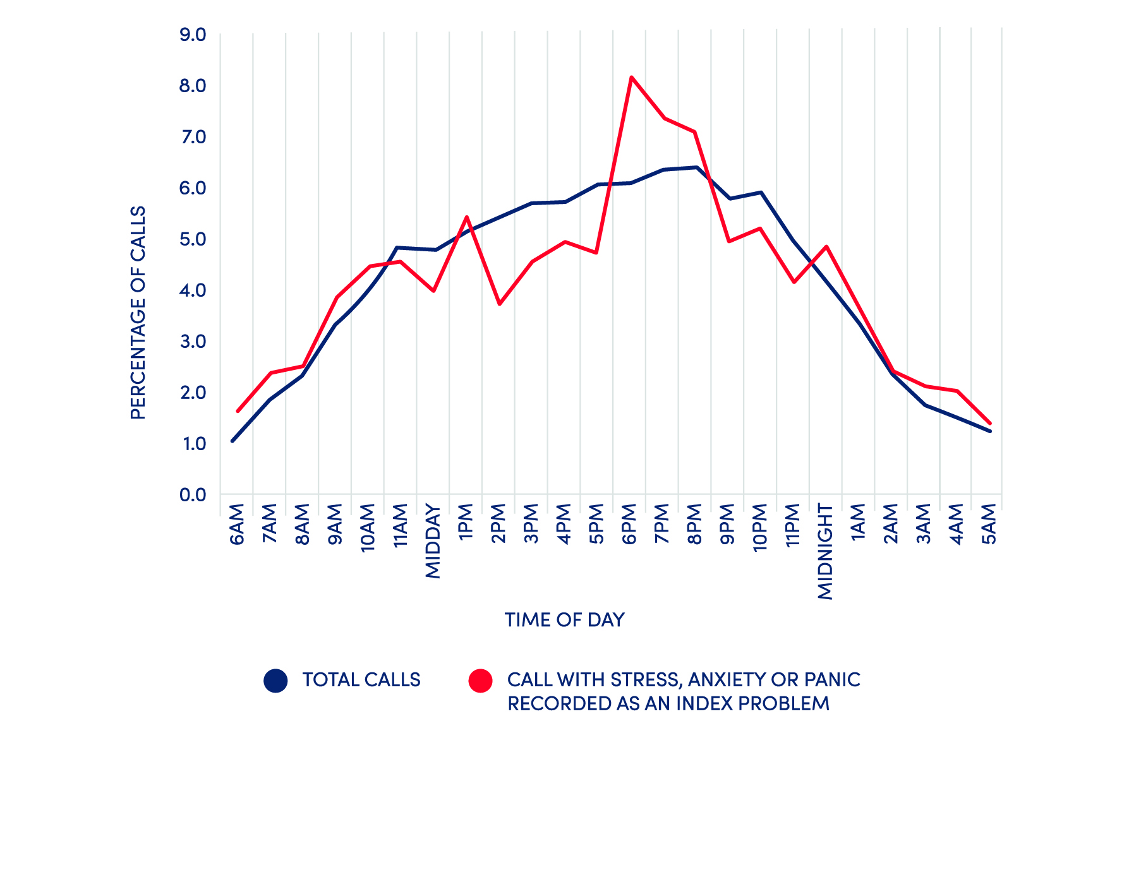
Calls by Time of Day
Mental Illness Verses Total Calls
Stress/ Anxiety Verses Total Calls
NATIONAL REVIEW OF ACCESS TO EMERGENCY SERVICES FOR THOSE EXPERIENCING MENTAL HEALTH AND/OR WELFARE CONCERNS

Slide 9
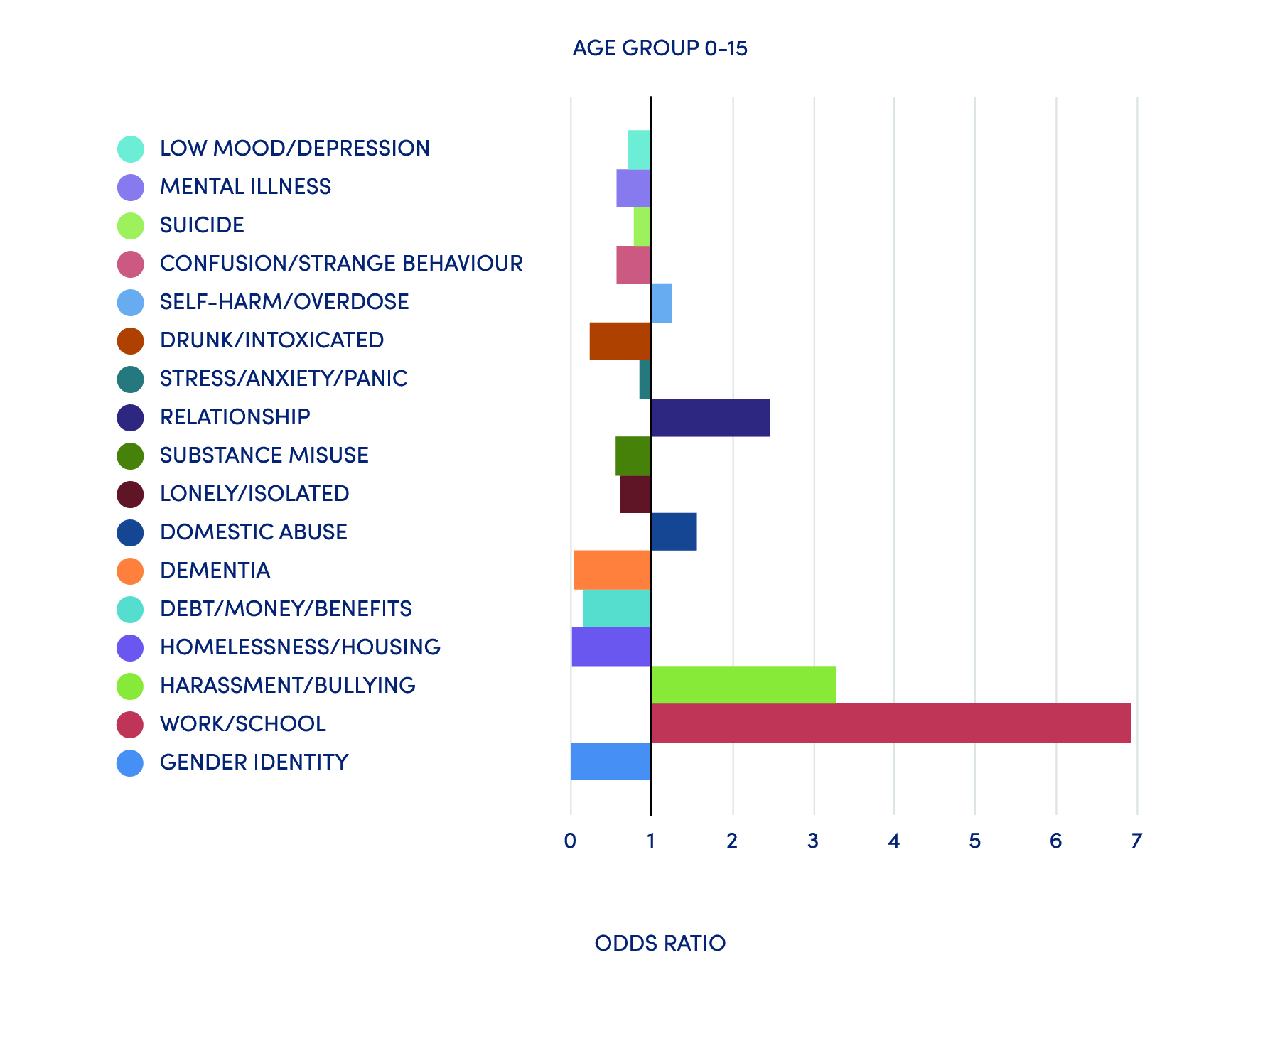
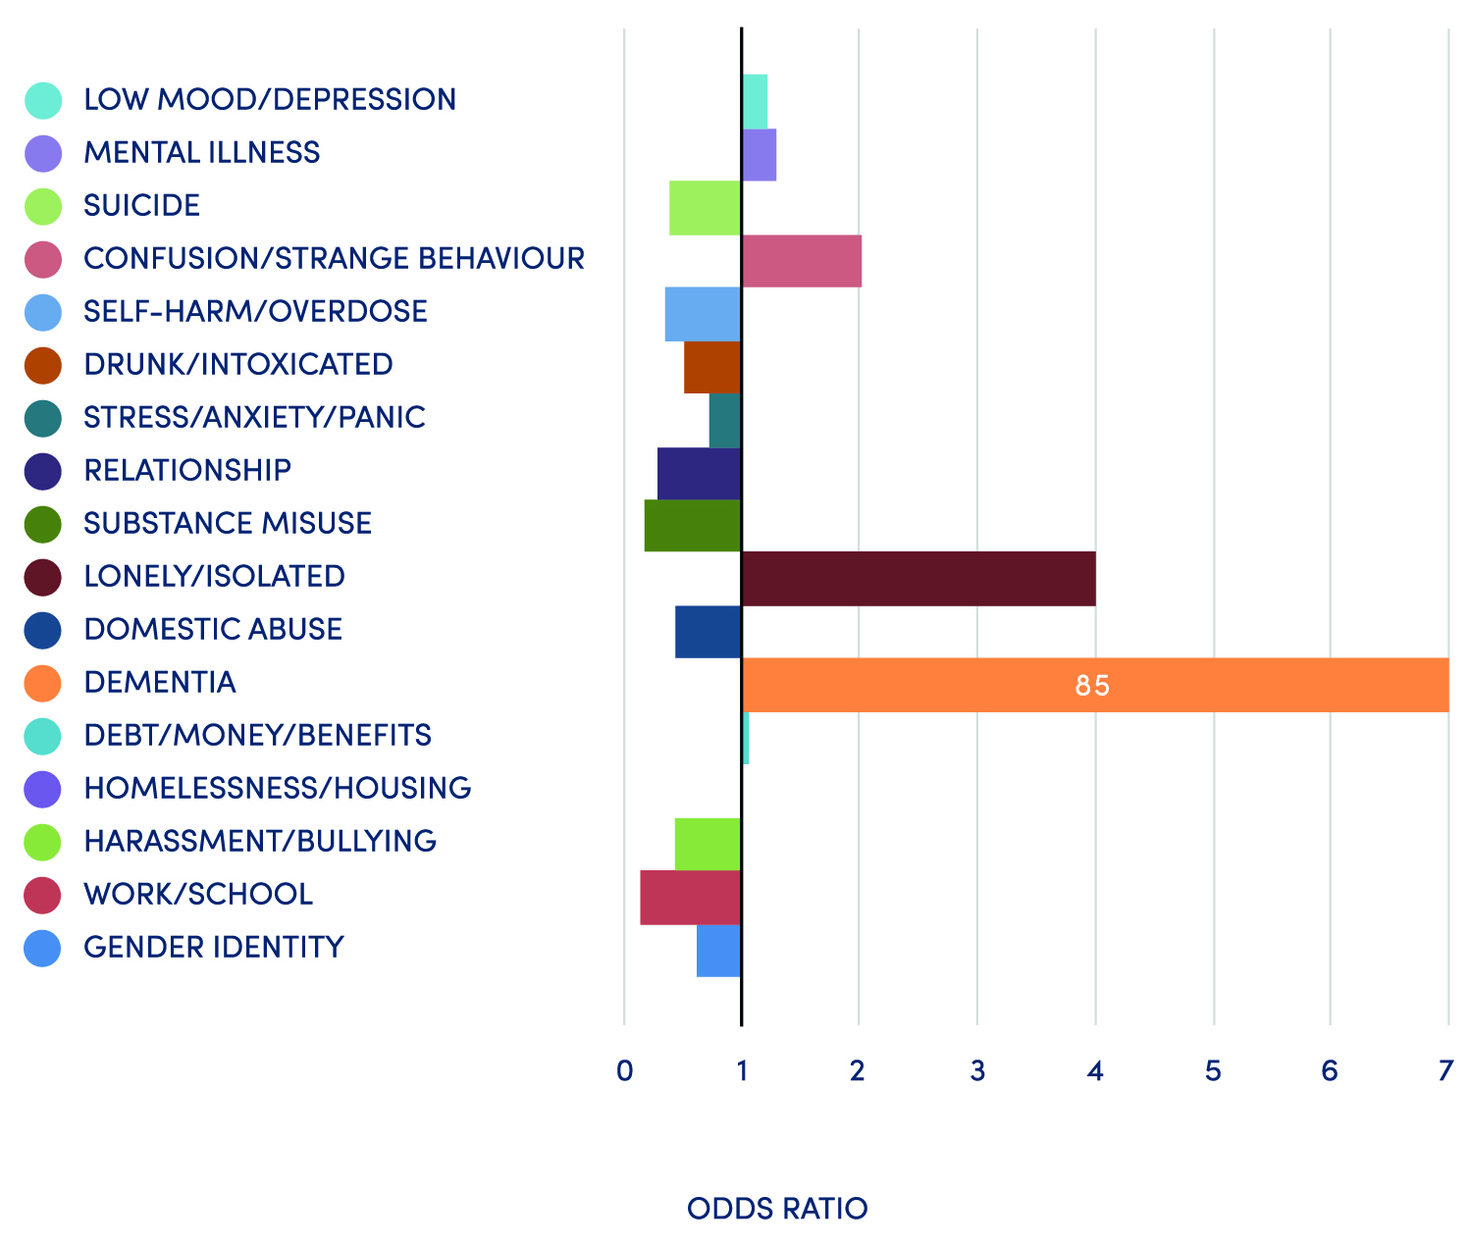
Odds Ratios age of person with index problem
Under 15
Over 65
NATIONAL REVIEW OF ACCESS TO EMERGENCY SERVICES FOR THOSE EXPERIENCING MENTAL HEALTH AND/OR WELFARE CONCERNS

Slide 10
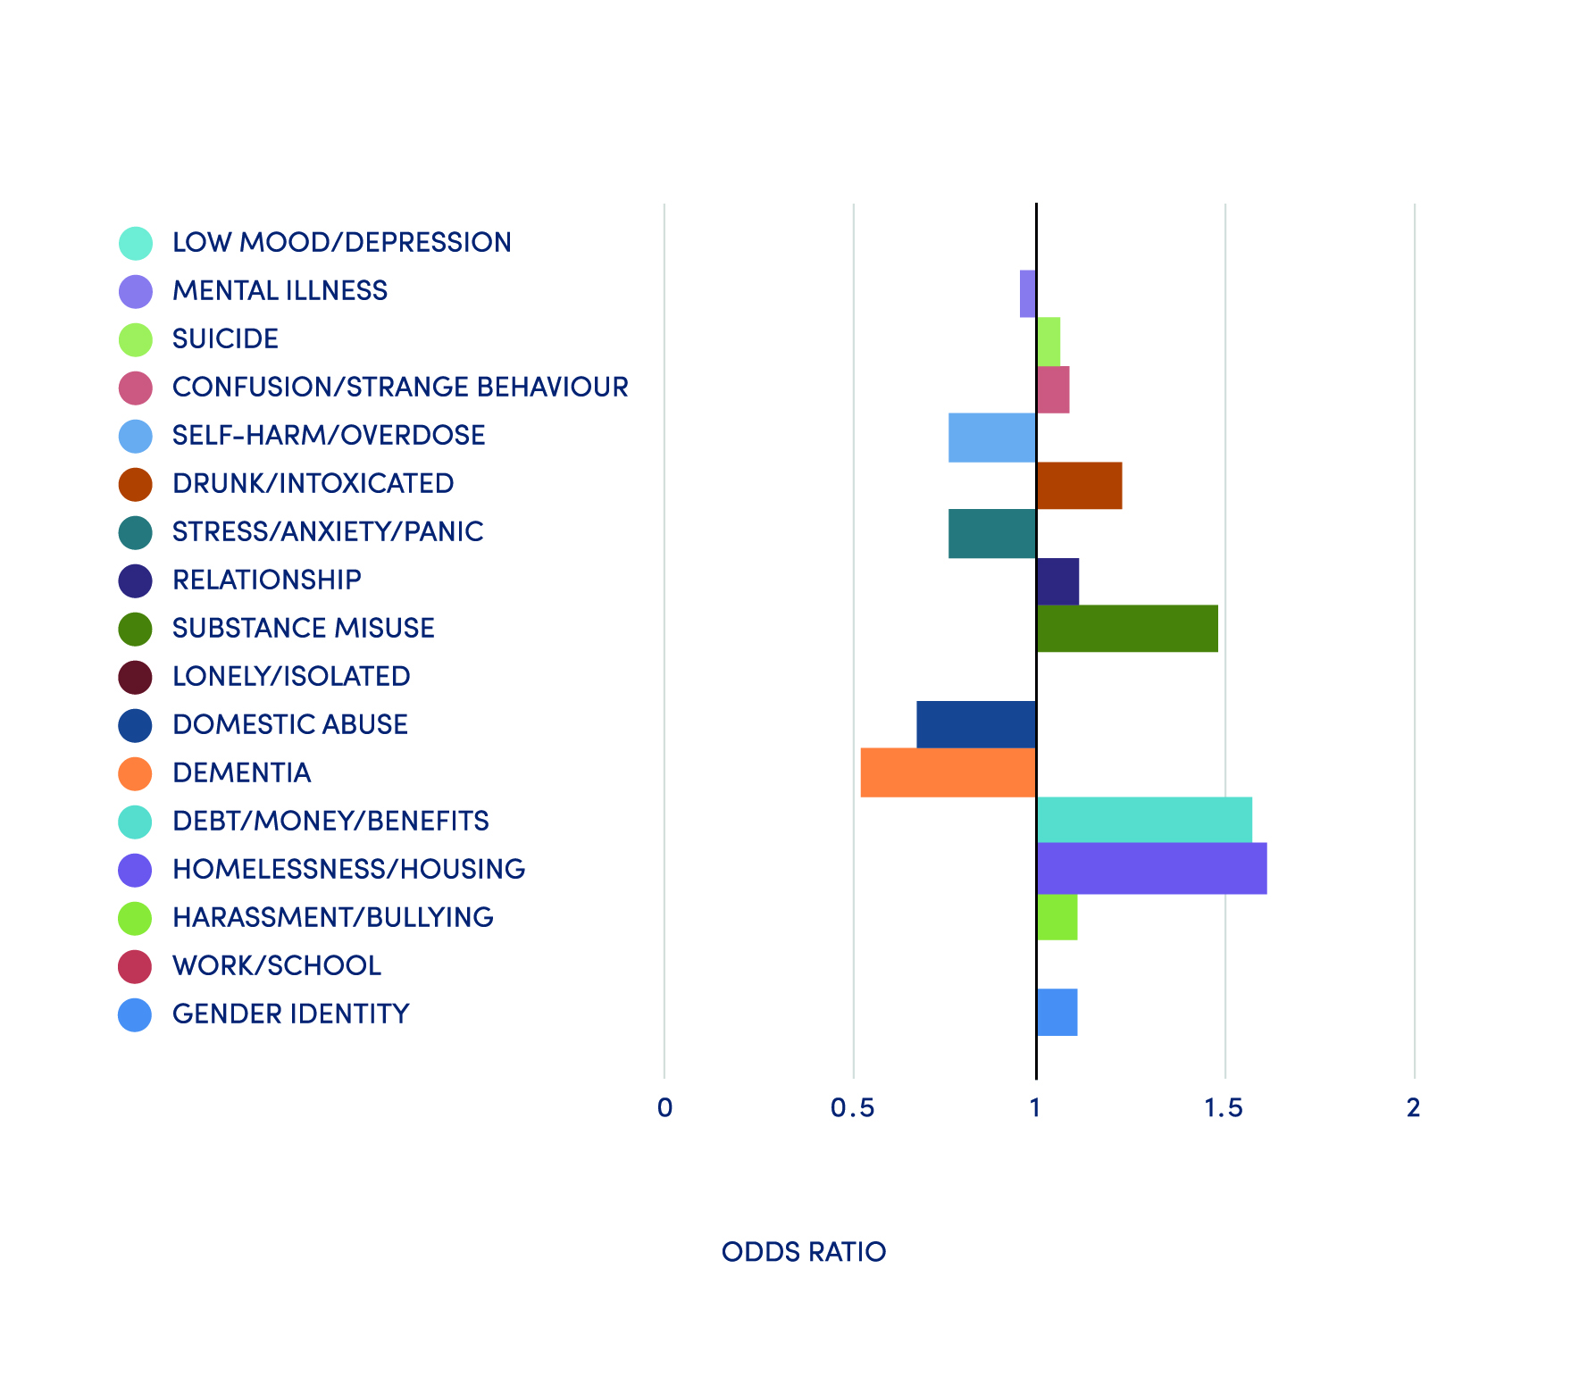
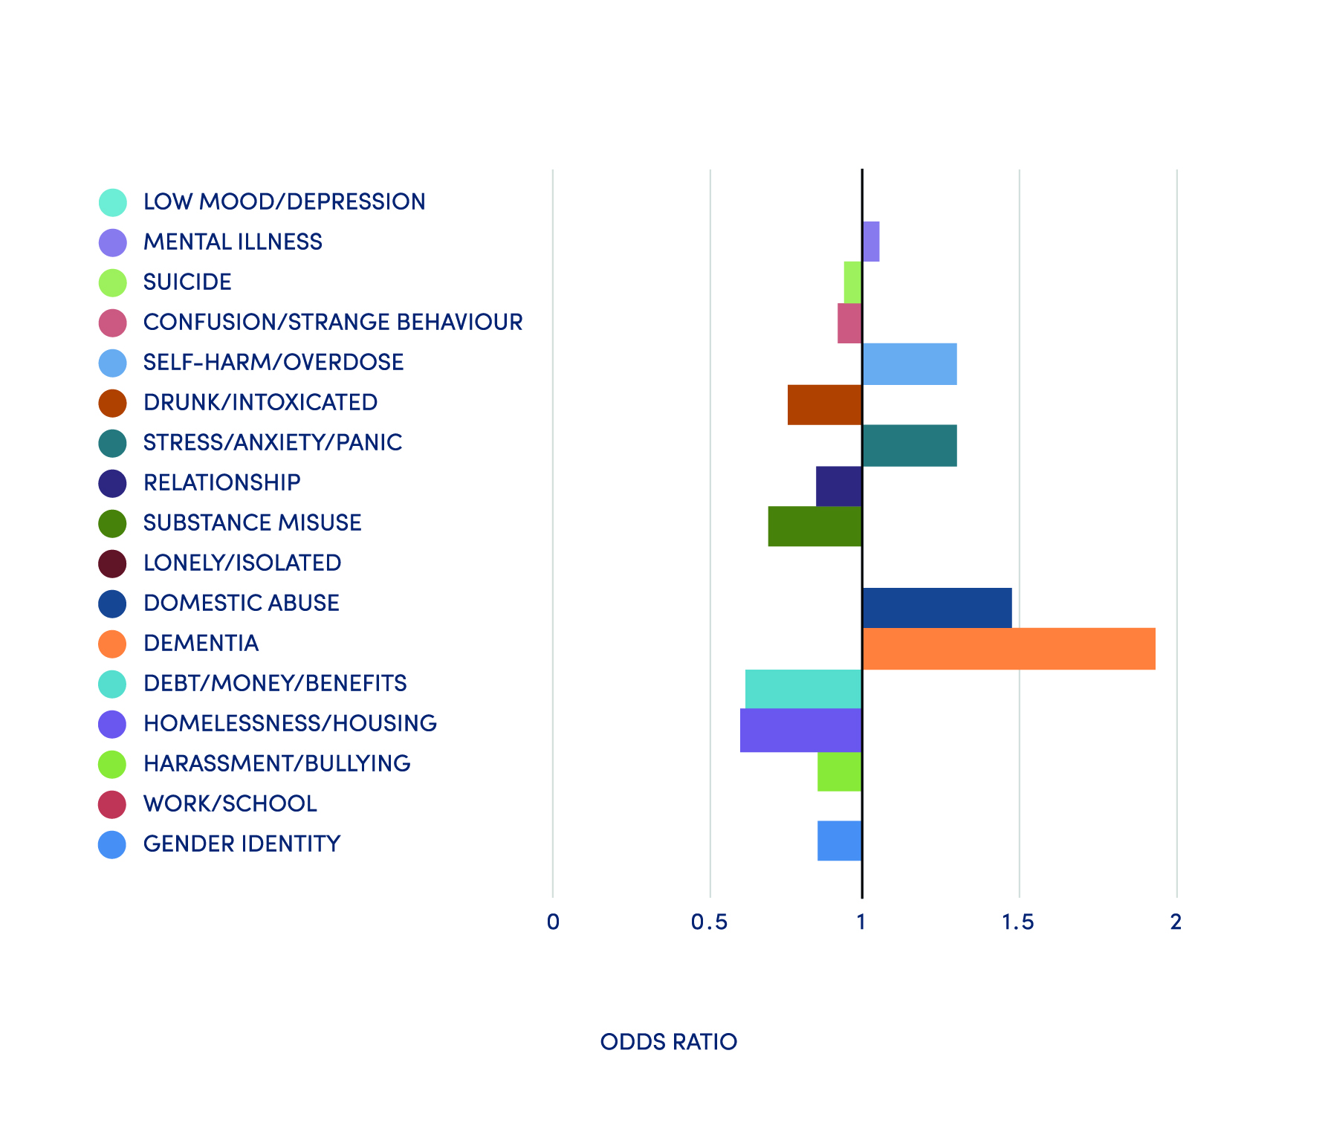
Odds Ratios gender of person with index problem
Male
Female
NATIONAL REVIEW OF ACCESS TO EMERGENCY SERVICES FOR THOSE EXPERIENCING MENTAL HEALTH AND/OR WELFARE CONCERNS

Slide 11
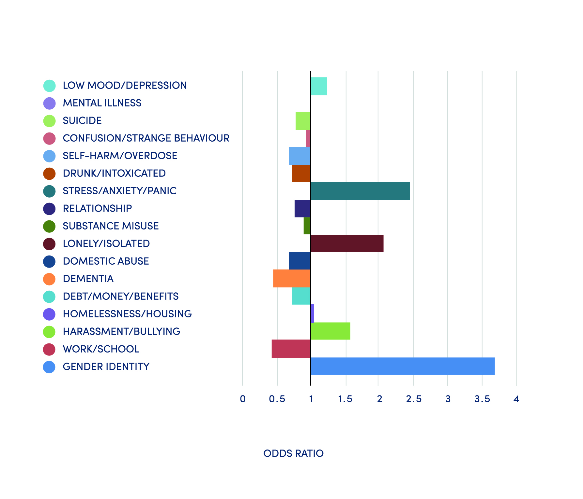
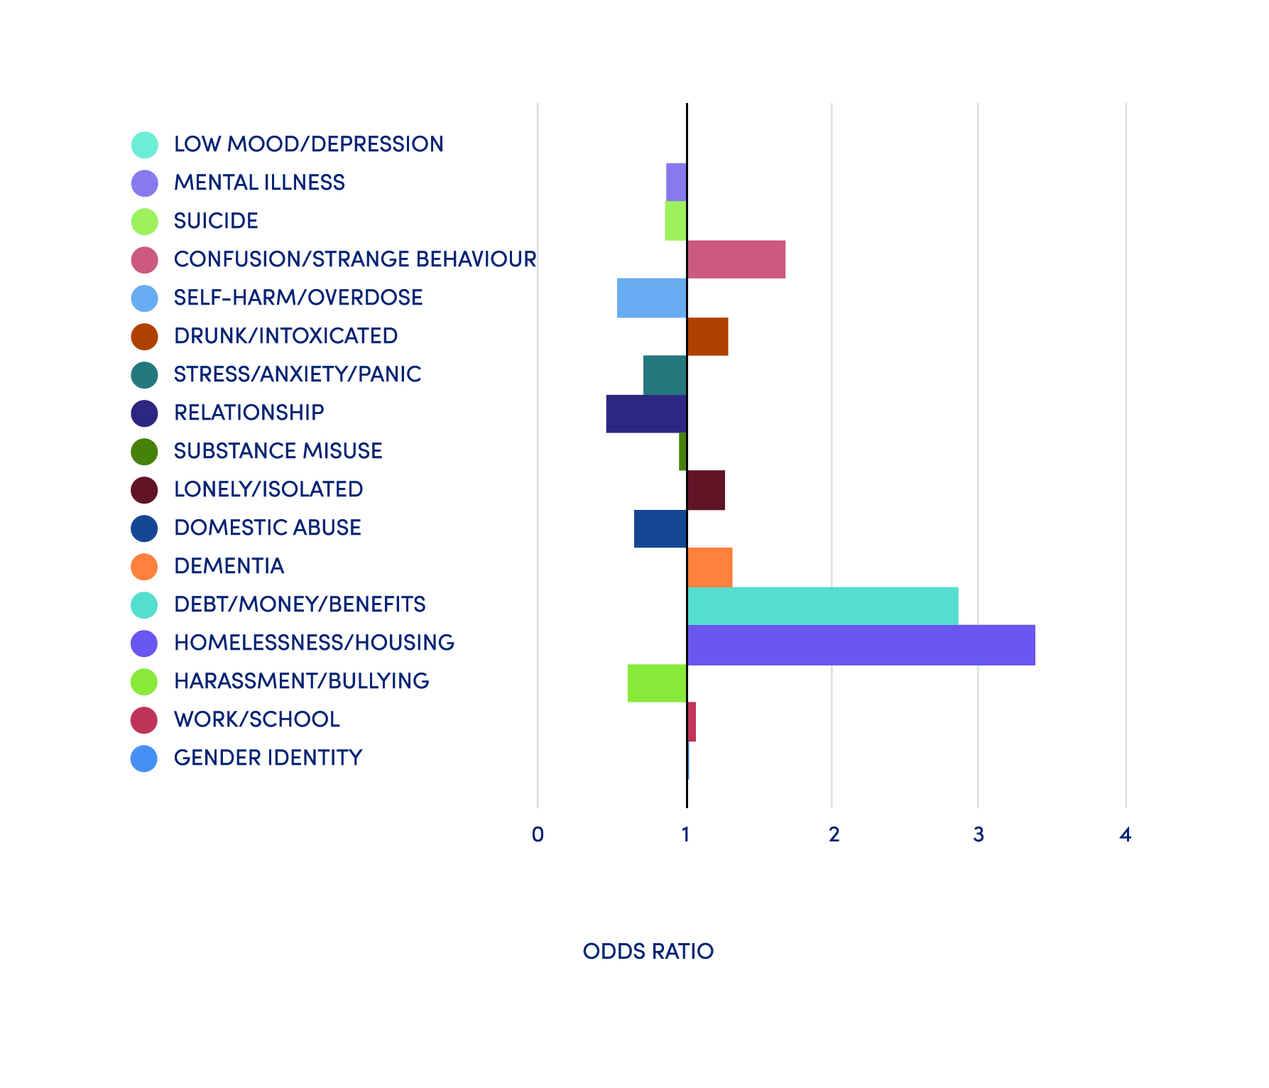
Index Problem for Type of Caller
Self–Callers
Public
NATIONAL REVIEW OF ACCESS TO EMERGENCY SERVICES FOR THOSE EXPERIENCING MENTAL HEALTH AND/OR WELFARE CONCERNS

Slide 12
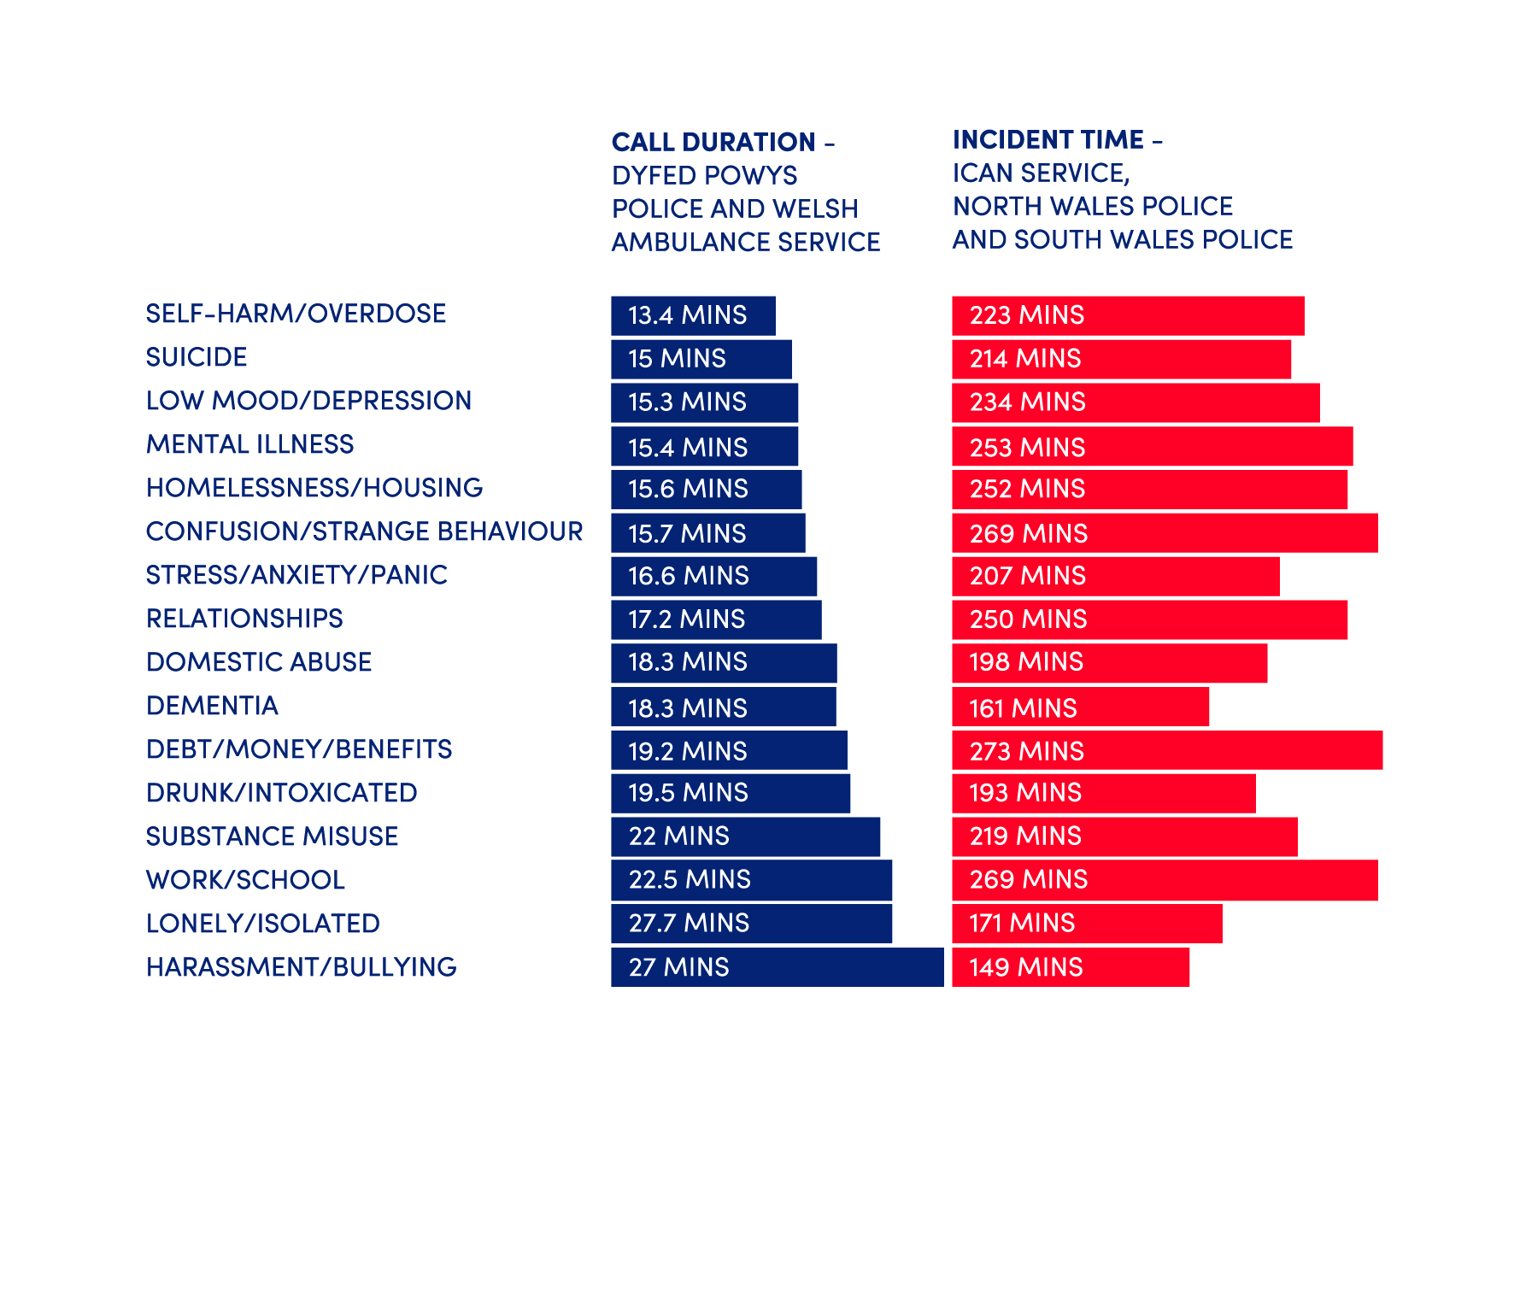
Average Duration of Call/Incident for all Index Problems (Split Between Two Groups)
NATIONAL REVIEW OF ACCESS TO EMERGENCY SERVICES FOR THOSE EXPERIENCING MENTAL HEALTH AND/OR WELFARE CONCERNS

Slide 13
Recommendations
Consistent real time data
Effective collaboration-multi-agency standards-whole system measures and indicators for success.
Welsh Government -urgent welfare concerns
NHS mental health -crisis plans
Facilities caring for vulnerable persons -robust ‘missing person’ protocols
NHS Wales-single point of entry
Trauma informed services
Partnership with the third sector, range of crisis prevention or response services
National communication campaign
Vulnerable groups- reduce barriers to accessing support in a crisis
NATIONAL REVIEW OF ACCESS TO EMERGENCY SERVICES FOR THOSE EXPERIENCING MENTAL HEALTH AND/OR WELFARE CONCERNS

Slide 14
Population Survey
Use: Which services have you/family used in last 12 months for mental health issues | %
GP | 62%
NHS community mental health services | 35%
Other | 18%
Voluntary Sector (MIND, HAFAL, Samaritans etc.) | 14%
A&E | 6%
MH online help (Silvercloud/Activate) | 5%
NHS inpatient mental health services | 4%
NHS Direct/111 | 3%
School counselling | 3%
Police | 3%
Ambulance service | 2%
Wales Drug & Alcohol helpline | 2%
C.A.L.L. | 2%
RESPONSE: Most Important when contacting services for mental health issue | %
Getting support from a caring, reassuring person, who has experience in mental health | 19%
Getting the best response for my situation | 13%
A quick response | 10%
Knowing what services are available locally | 10%
Having face-to-face support | 9%
Getting support from a medical professional | 9%
A 24 hour service | 6%
Getting advice that avoids the need to visit A&E | 4%
Easy to remember contact details | 3%
Having support in my first language | 1%
AWARENESS: Which services first thought of as providing mental health care and support | %
NHS Direct/111 | 42%
Voluntary Sector (MIND, HAFAL, Samaritans etc.) | 20%
GP | 19%
Other | 9%
NHS community mental health services | 5%
Friends/family | 3%
Social Services | 1%
Ambulance service | 1%
Police | 0.3%
Private mental health services (BUPA etc.) | 0.2%
NATIONAL REVIEW OF ACCESS TO EMERGENCY SERVICES FOR THOSE EXPERIENCING MENTAL HEALTH AND/OR WELFARE CONCERNS

